Slide 1
Getting Ready
for
Kindergarten!

Slide 2
Supply List
The supply list will be available on the kindergarten page on the school website. Please note which supplies should be labeled with your child’s name and which ones will be added to our community supplies.
We would like to highlight
a few items…
Notes:
Amanda

Slide 3
Headphones
When purchasing headphones please be aware that students will be using them all throughout day on a daily basis. It is recommended that you purchase some that cover their entire ear.
Here are some pictures… .
Notes:
Julie

Slide 4
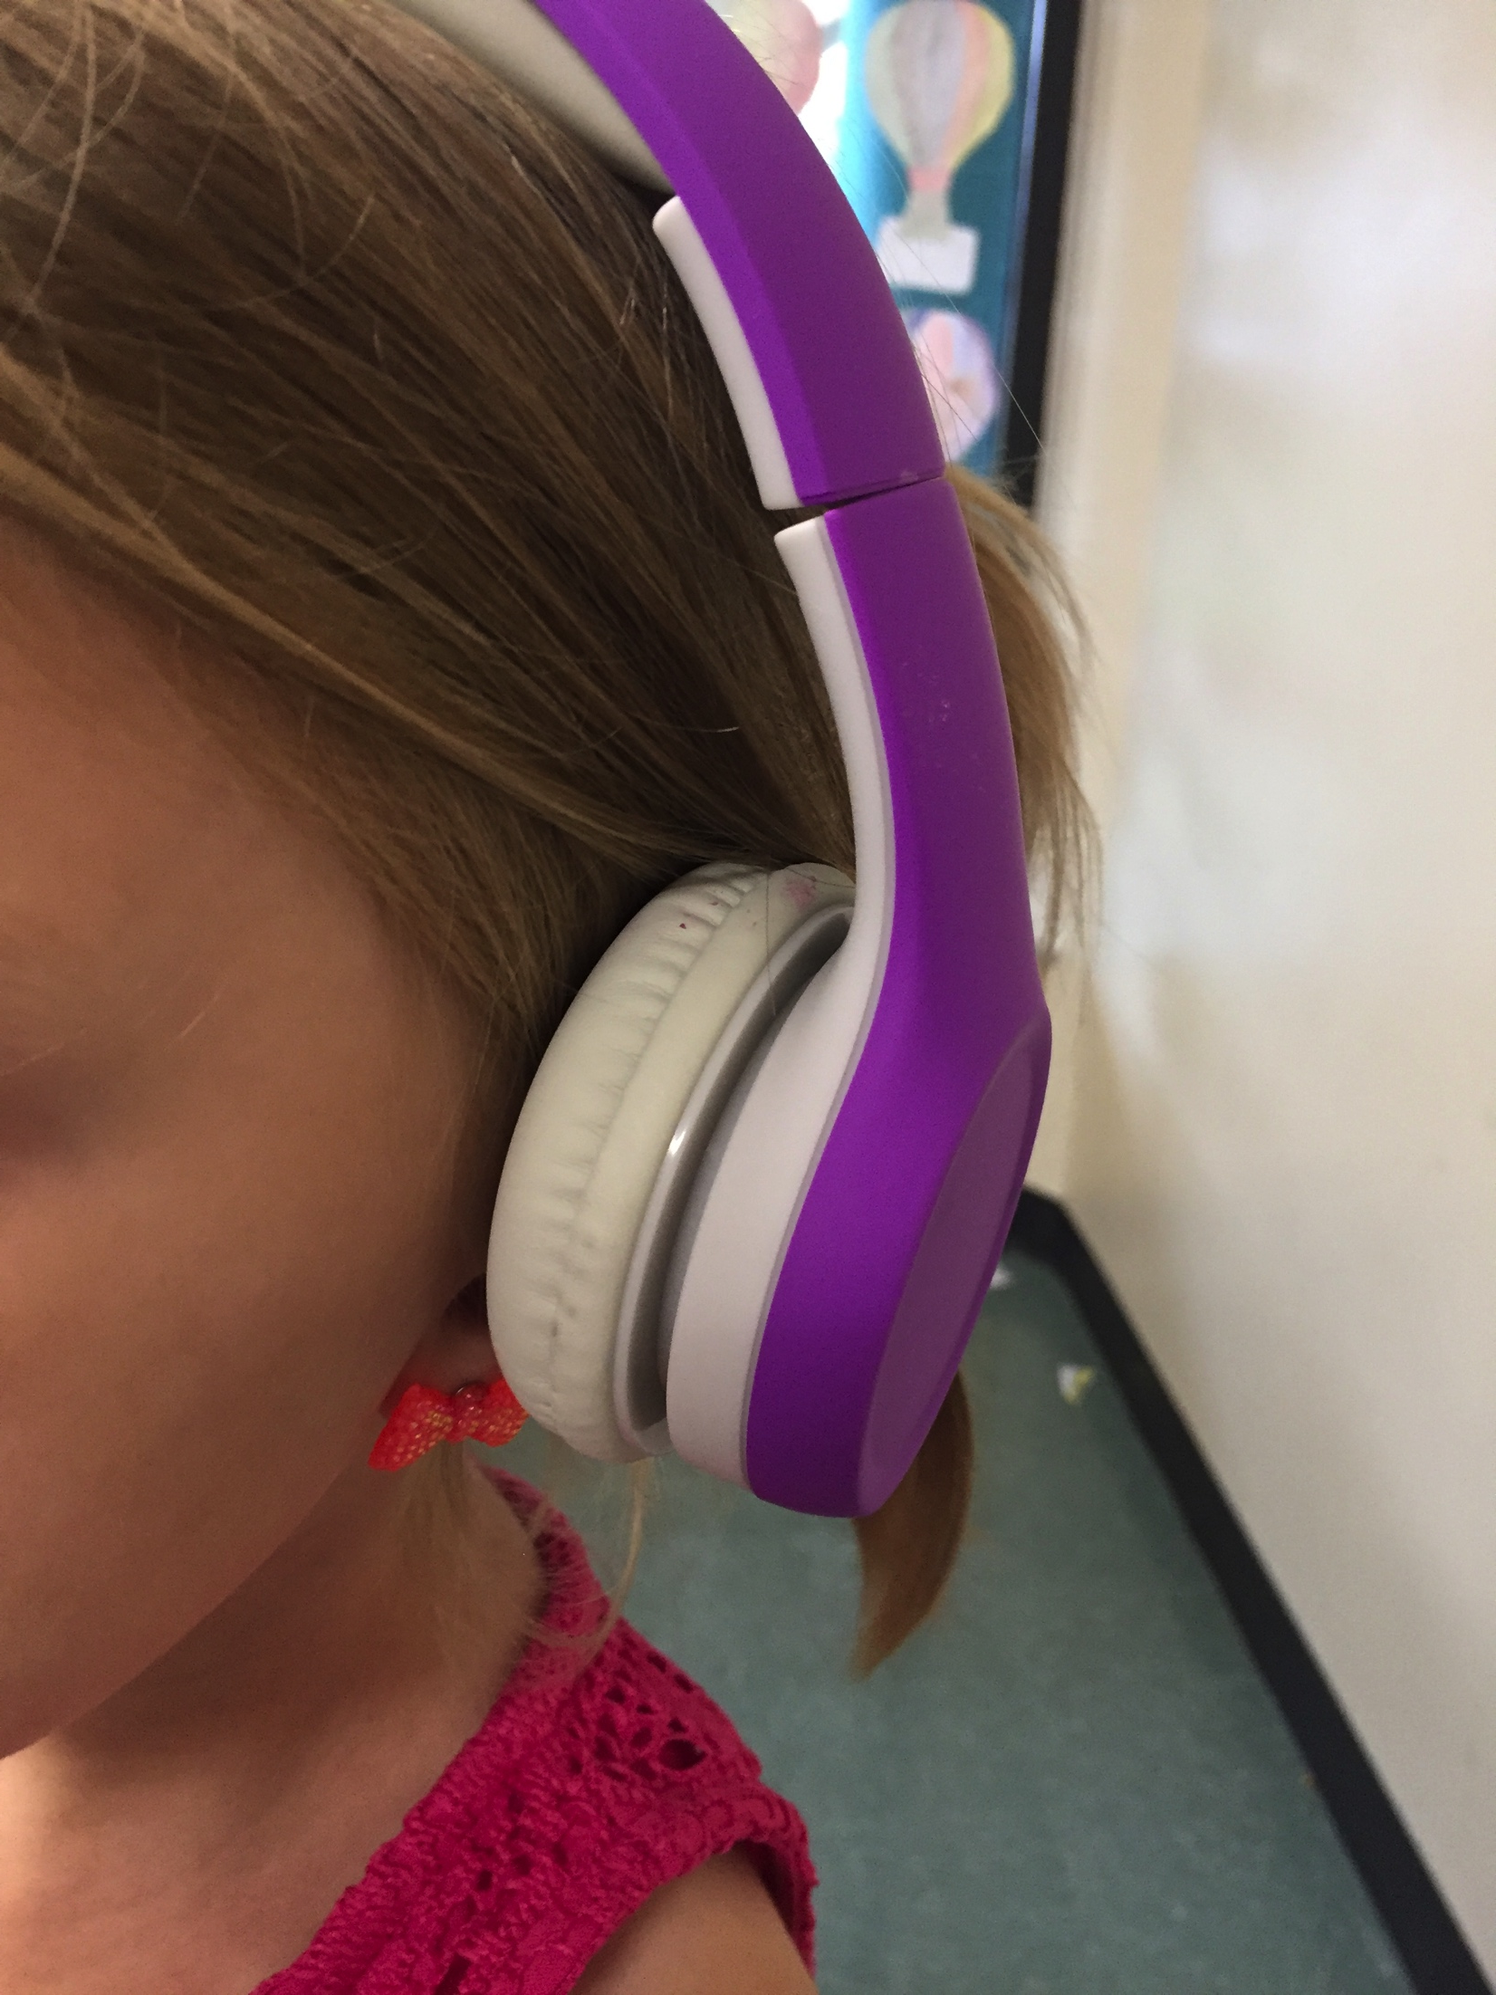
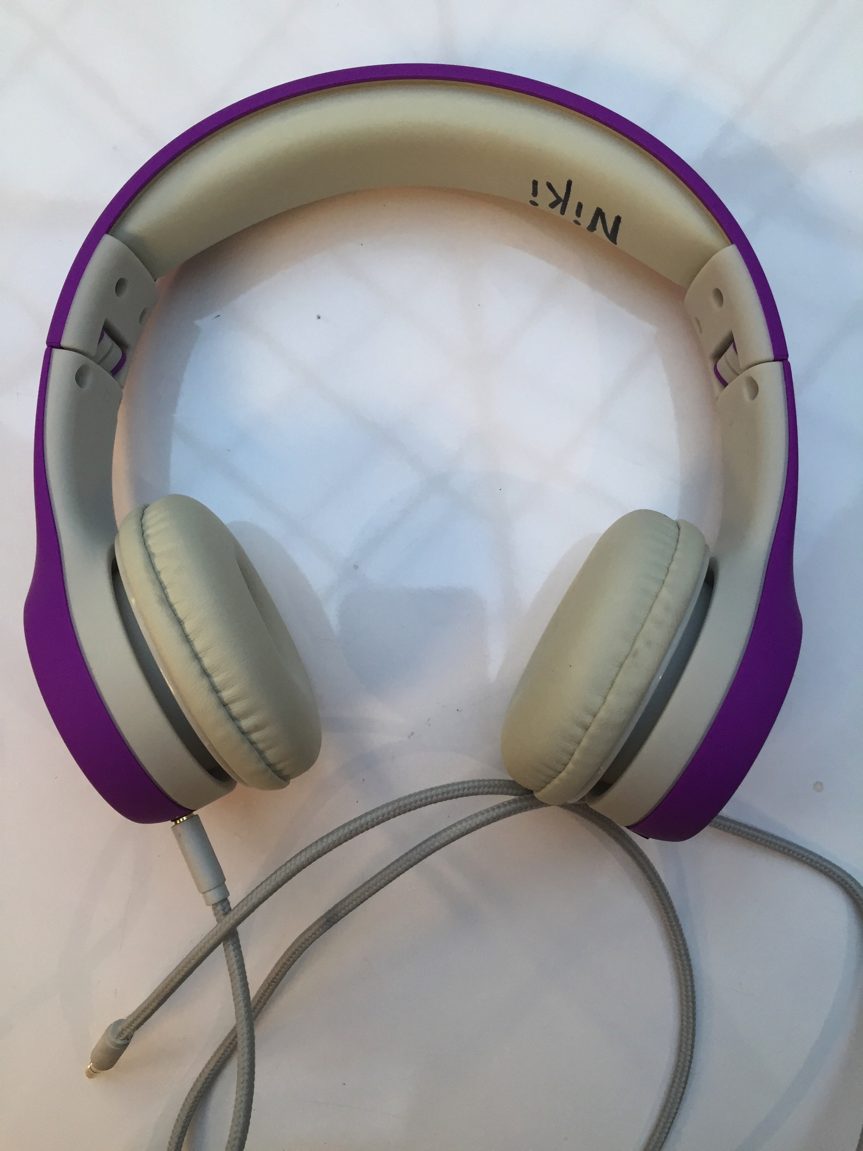

Slide 5
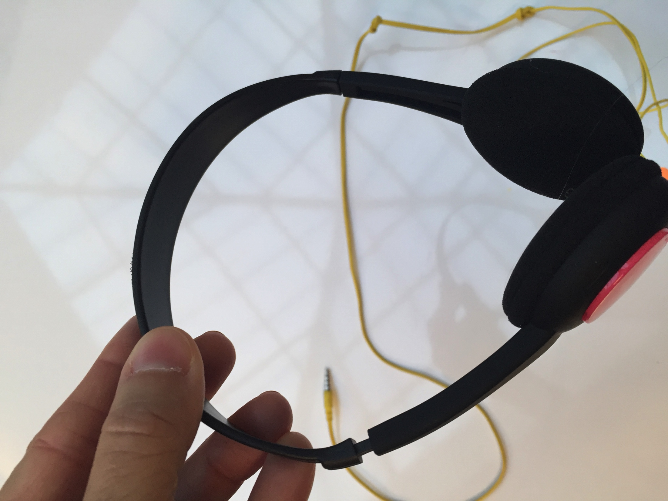
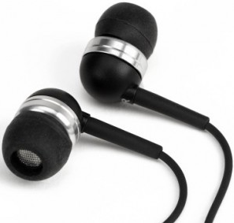
Please do not purchase:
Low Quality Headphones
Ear buds

Slide 6
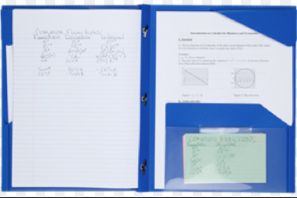
5 Star Mead Plastic Folder with Prongs
This folder will be sent back and forth between home and school daily. We want this folder to last all year and have found that this brand holds up the best.
Notes:
Morgan

Slide 7
Hand Sanitizer
Please be aware that our hand sanitizer MUST be alcohol free in order to protect our waxed tile floors.
Notes:
Krsiti

Slide 8
A few suggestions
Be sure to label any personal items that you do not want your child to lose (jackets, lunch boxes, cups, etc.)
Keep an extra change of clothes in your child’s backpack
If your child does not know how to tie his/her shoes Velcro shoes are recommended
All kindergarten students are expected to use
the restroom 100% independently.
Notes:
Sara

Slide 9
Kinder Camp
Kinder Camp will be July 24-27 half days
Cost is $100 which includes a t-shirt, craft supplies, pizza party on the last day, and experiment supplies
Must be registered and paid by June 29th
Registration brochure can be found in your kindergarten registration packet
Notes:
Barb

Slide 10
Summer Assessment
Students will be given a kindergarten entry assessment to assist with creating well-balanced classes.
Students who attend Kinder Camp will be automatically assessed during camp.
If your child is not attending, you will be contacted to sign up for an assessment time.
Notes:
Toni

Slide 11
Thanks for coming to our kindergarten information night. If you have any questions that were not addressed, please post them on the parking lot and we will answer them via the Kindergarten website page.
We look forward to next school year!
Notes:
Teresa

