Slide 1



Welcome to the 5th Grade Virtual Open House

Slide 2
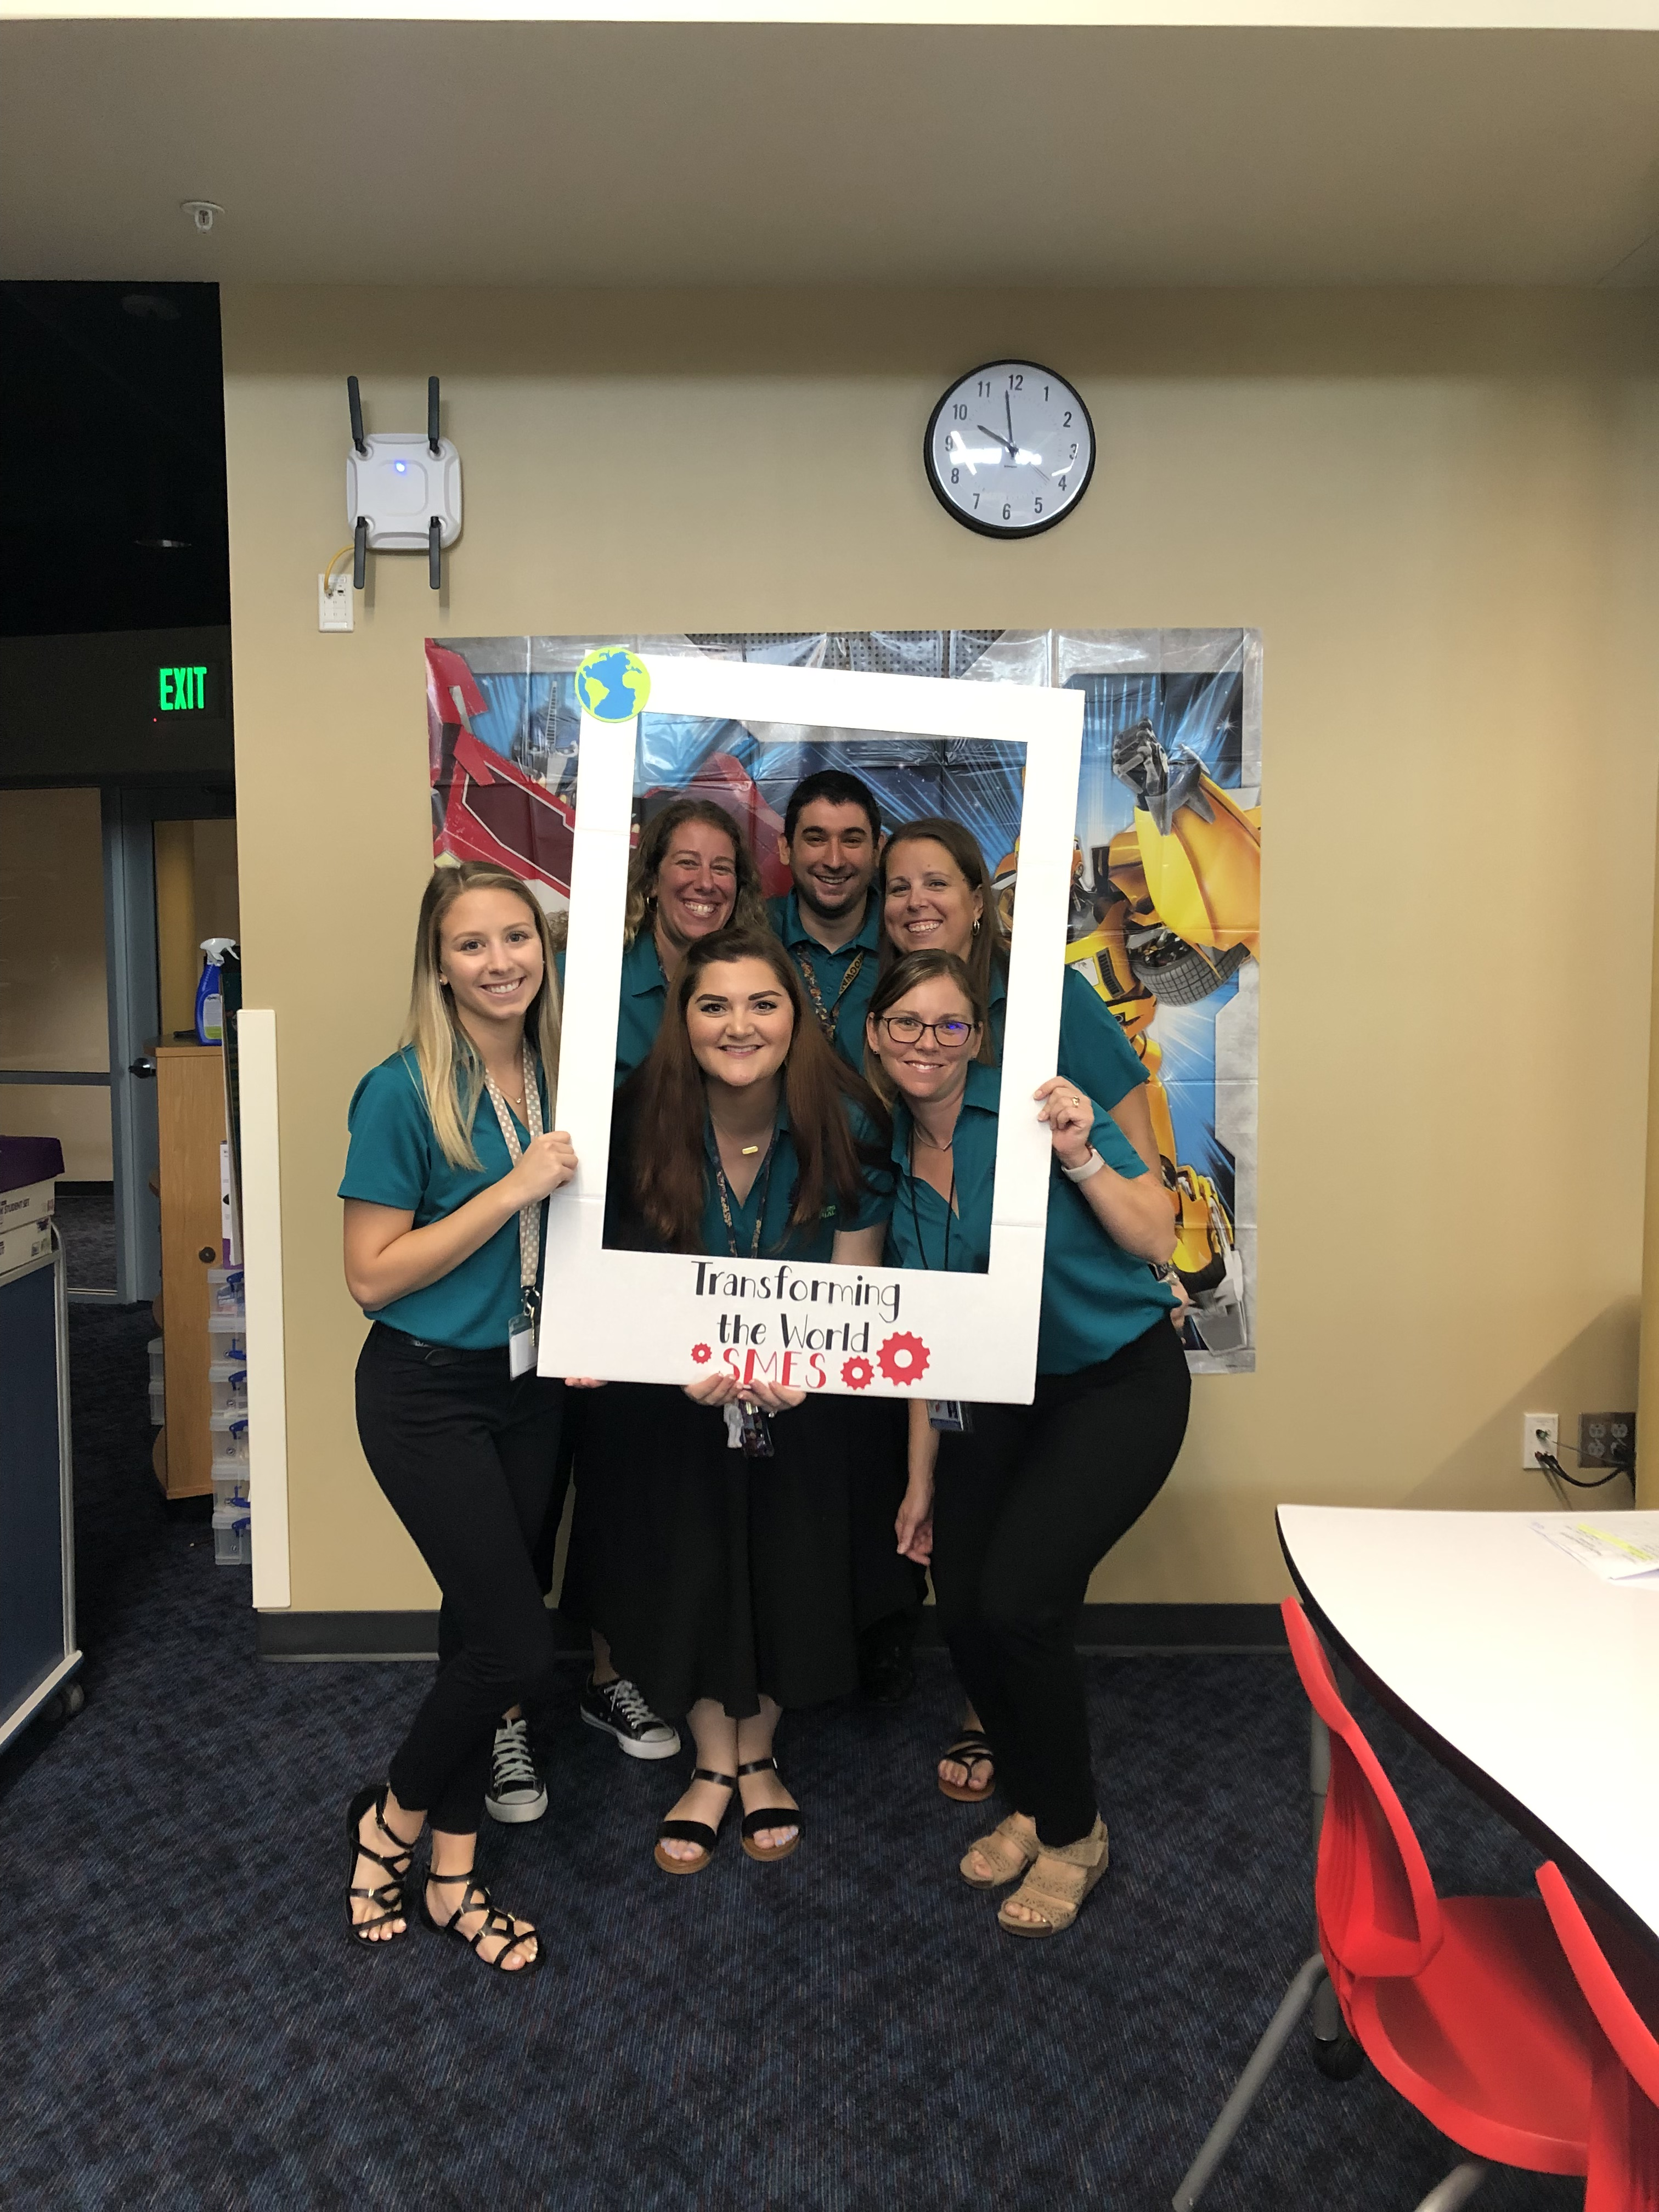
Introducing the Team
Our team this year is made up of Mr. Diaz, Mrs. Gonzalez, Ms. Haas, Mrs. Kelley,
Mrs. Regateiro and Ms. Stephenson
We are very excited to spend the school year with your 5th grade Stallions!

Slide 3

School Time
The first bell is at 8:30 a.m.
Students need to be in class no later than 8:40 a.m. We begin our learning promptly at 8:40 so it is imperative students are on time.
Dismissal: 2:45 - 3:00 p.m.

Slide 4
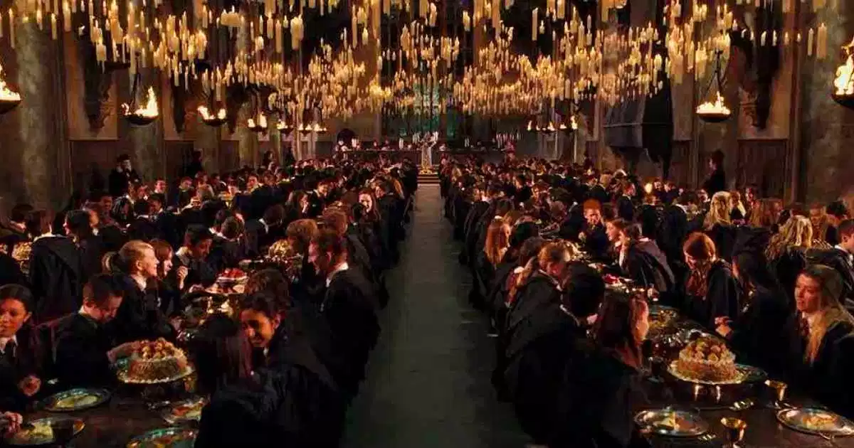
Specials and Lunch Times
Lunch: 1:10 – 1:40
Specials: Monday 9:35 – 10:15
Tuesday 9:35 – 10:15
Wednesday 9:35 – 10:15
Thursday 9:35 – 10:15
Friday 9:35 – 10:15
*See teacher for the days that your child has P.E., Music, and Art

Slide 5

Changes in Dismissal / Early Pickup
If your child will be going home a different way than normal please call the front office at 813-794-1500 and let them know how your child will be going home.
Please do not email or DoJo message your child’s teacher this information, because we are not always able to check our messages during the day.
Your cooperation in this matter is greatly appreciated!

Slide 6

Communication plan
Our team uses email and DoJo our as our primary forms of communications. We have listed our emails below. We will do our best to respond within 24 hours.
Mr. Diaz: andiaz@pasco.k12.fl.us
Ms. Gonzalez: sgonzale@pasco.k12.fl.us
Ms. Haas: shaas@pasco.k12.fl.us
Mrs. Kelley: akelley@pasco.k12.fl.us
Mrs. Regateiro: aregatei@pasco.k12.fl.us
Ms. Stephenson: hstephen@pasco.k12.fl.us

Slide 7
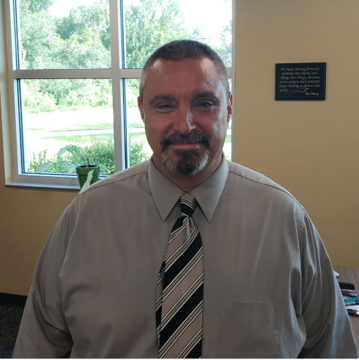
Security Guard
Our new security guard is Mr. LaVare. All school security guards will be armed while they are on-campus.

Slide 8
Website
Please be sure to check the SMES website for important events.
https://smes.pasco.k12.fl.us

Slide 9
Volunteer
If you would like to chaperone a field trip or help in the classroom this year you must apply.
If you were a volunteer last year, you must renew your application.
Please fill out a volunteer form today using this link.
Due to Covid, we are not allowing volunteers on campus at this time. We hope that we will be able to host visitors before the end of the year.

Slide 10

PTA
The class with the most parents/guardians joining will earn a pizza party. This is a great way to support our school! If you need further information please contact the front office on how to become a member.

Slide 11

Custody Issues
If you have a custody issue, please let the front office know. Student safety is our top priority.

Slide 12

Team Behavior Expectations: RCA App
It is important that our 5th graders follow all our school rules. We will reward behavior with RCA House points. This is a way to see in real time how each House is doing and to see how students are earning points for their positive behavior.

Slide 13
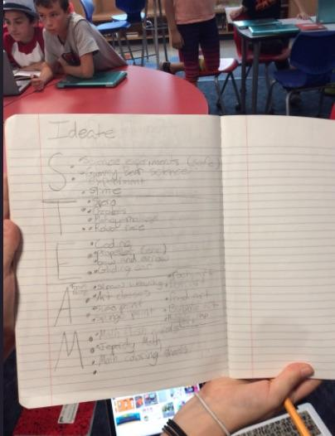
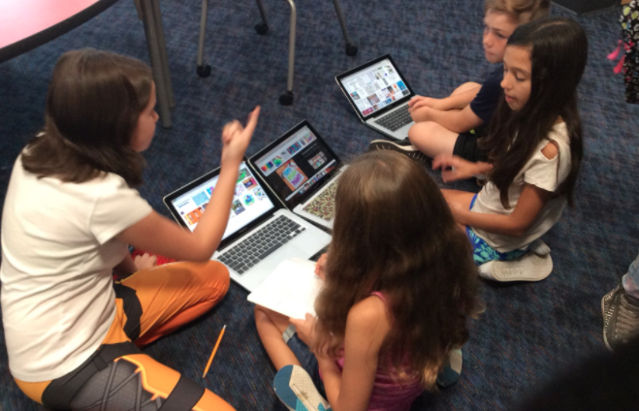
Defining Design
Defining Design is an opportunity for students to work through the design process to solve a real-world problem with a focus in compassion.

Slide 14
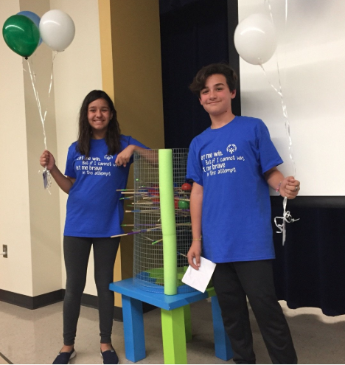
Design on Display
This is a night where students will showcase their design projects. Parents can visit the classroom to see all the projects that were completed. It ends with awesome student speakers giving TED Talks on their projects.

Slide 15
SMES LATIC Structure
Student Schedules: Students will be responsible for scheduling their days.
Task: Students will have a problem-based task to drive their learning.
Rubric: Students will use their rubric to help guide their work.
Activity List: Students will have a choice on how they learn and will be expected to use this to help them schedule their day.
Mini Lessons: Students will be invited mini-lessons based on student needs.
Students will have the opportunity to work with all the 5th grade teachers throughout the year.

Slide 16
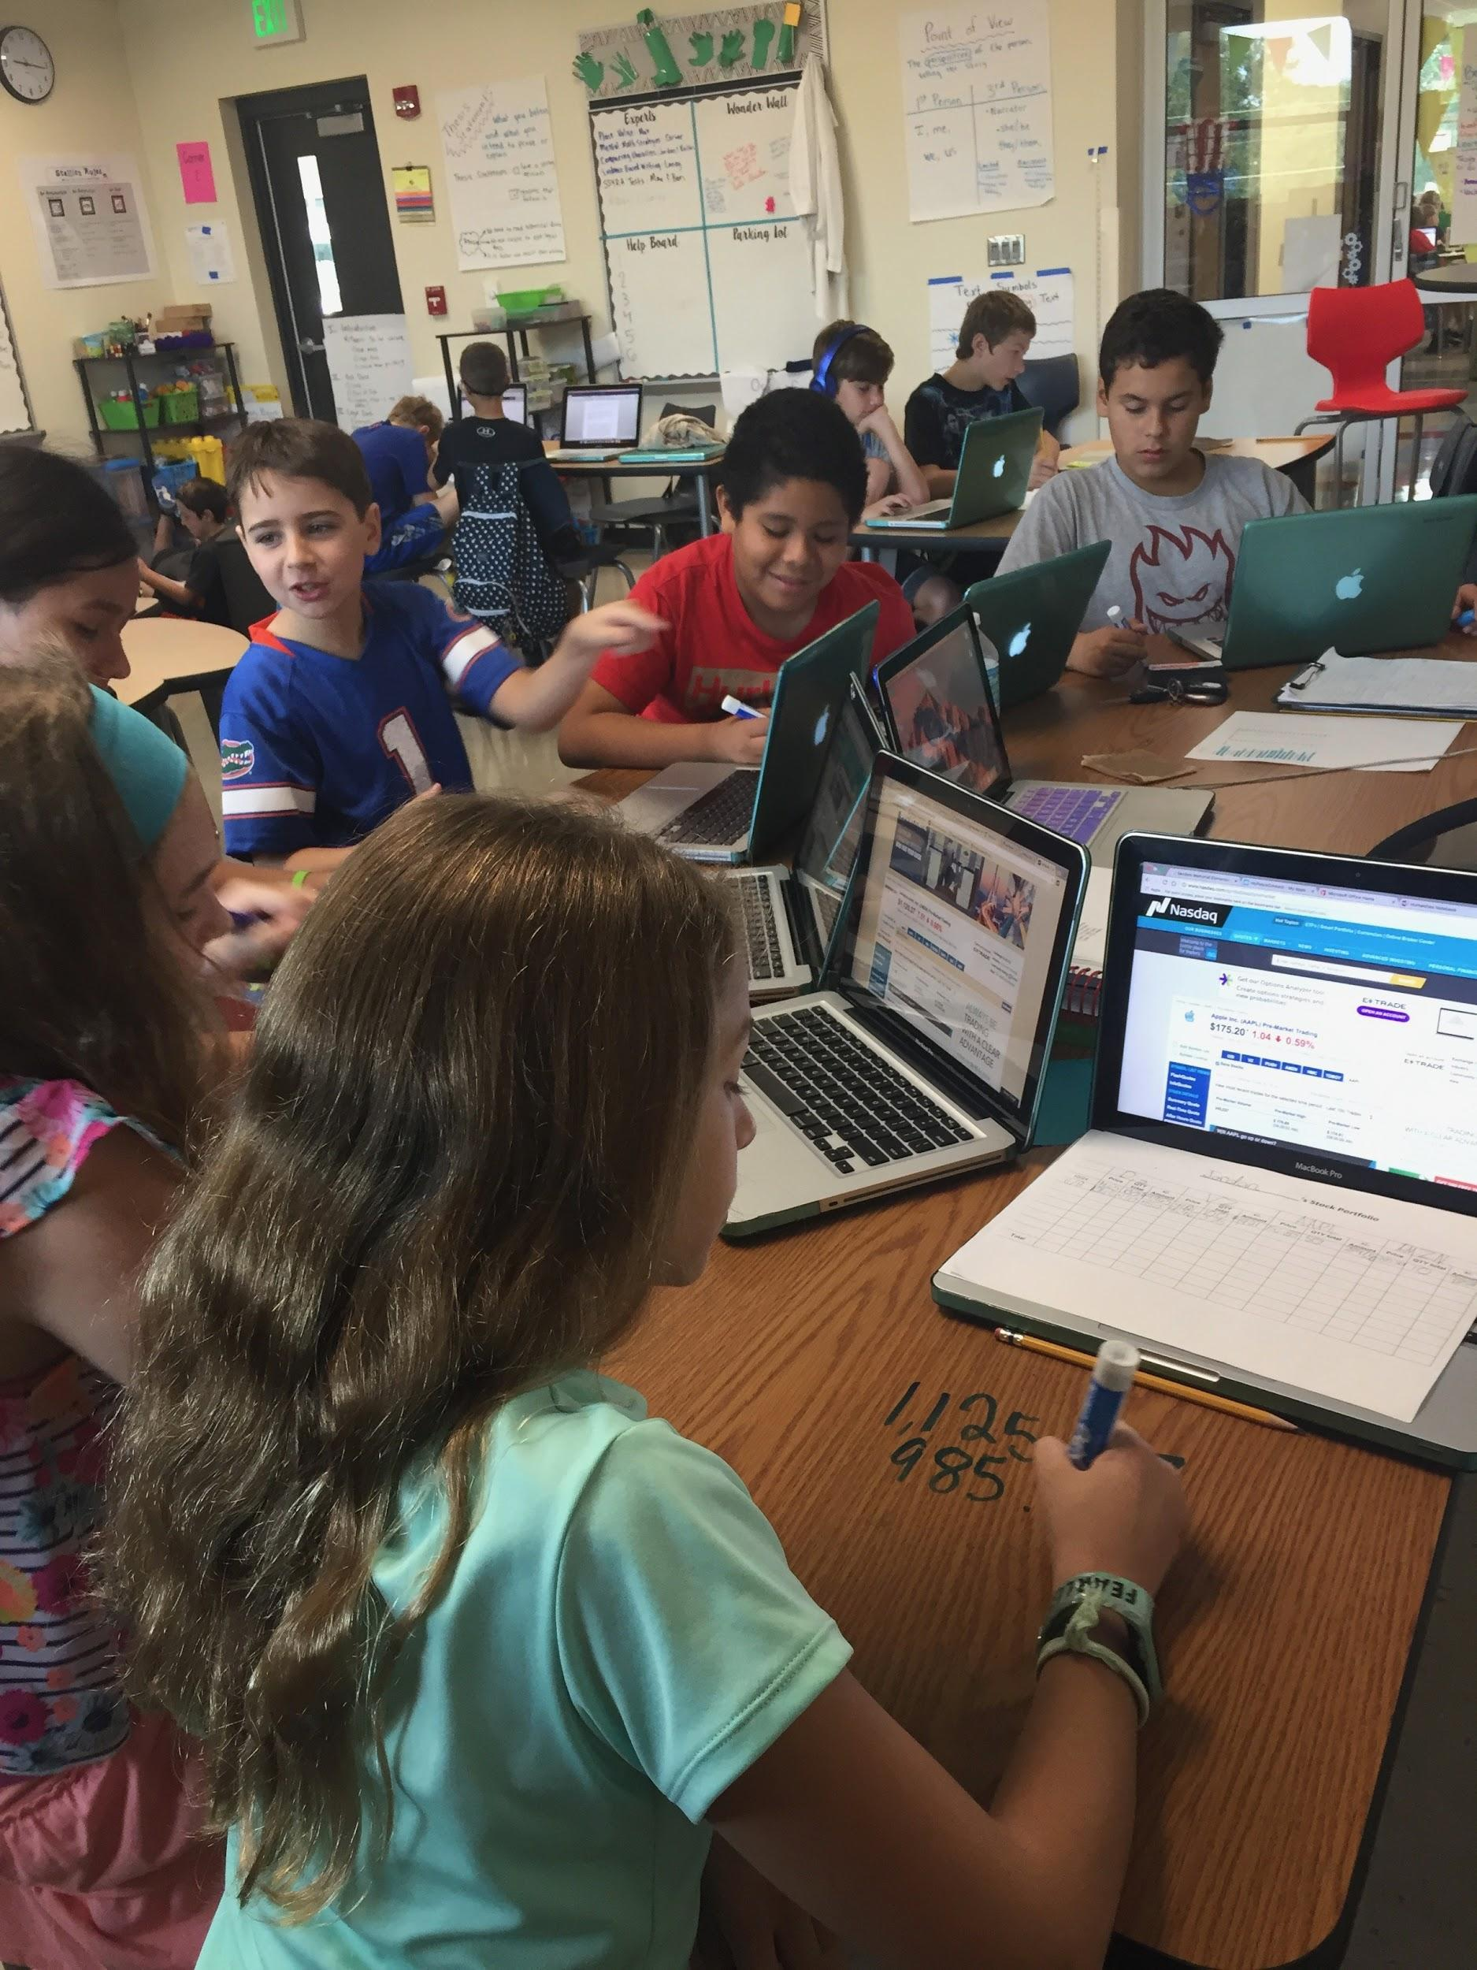
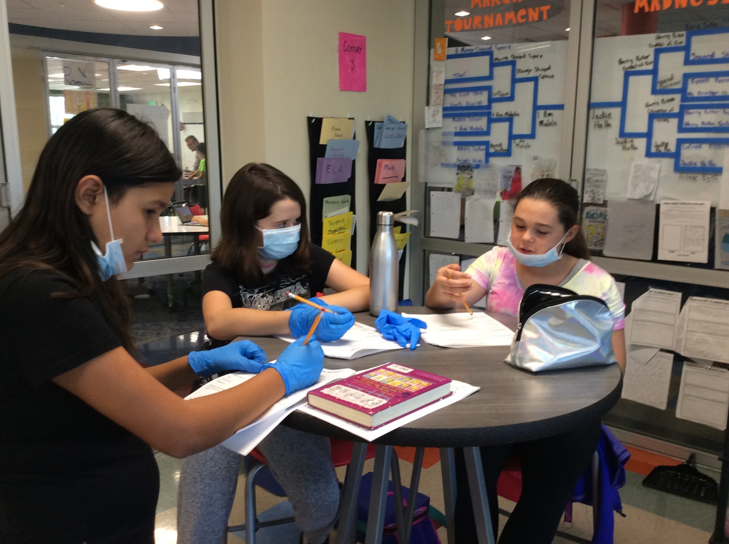
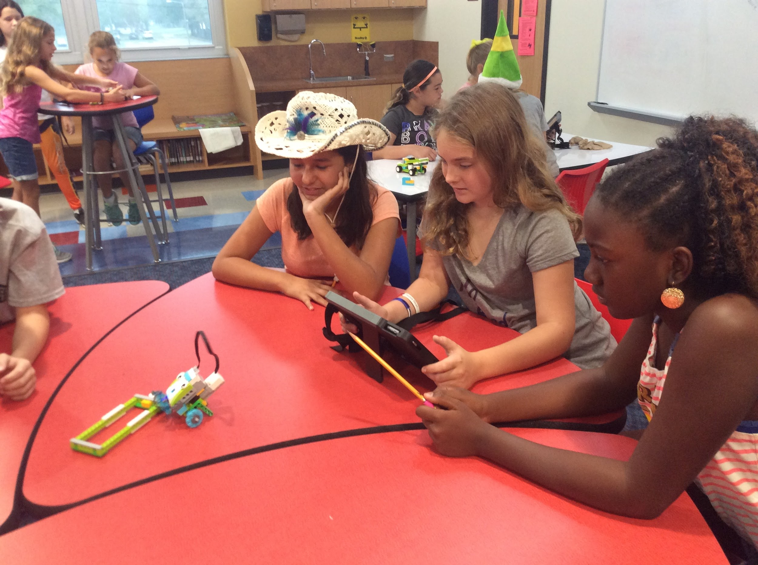
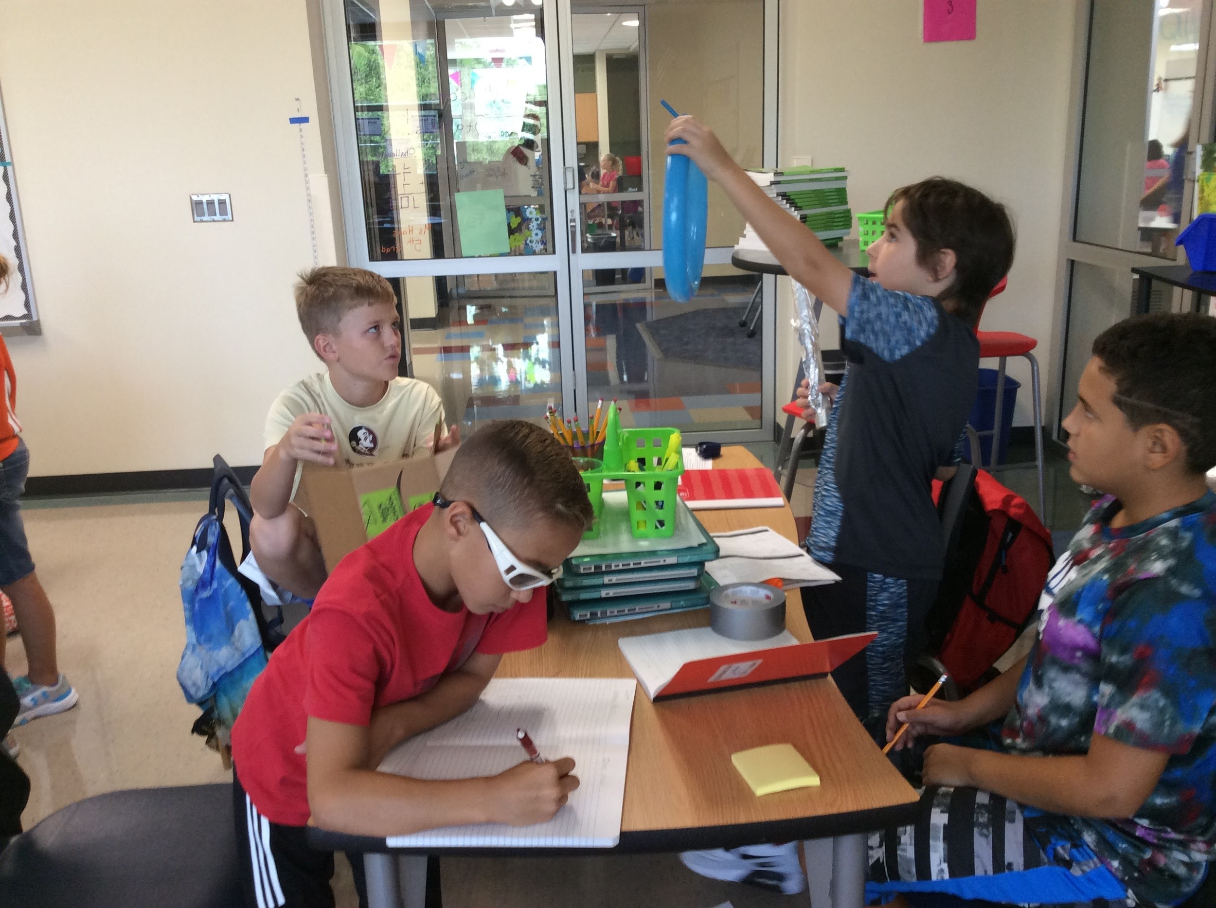
STEAM School
We are the first and only elementary STEAM Magnet school in Pasco County. We are proud to give students the opportunity to work through the design process using problem-based tasks. Throughout this school year they will also have the opportunity to work with different tools to enhance their learning. We are excited to give them these opportunities this year!

Slide 17

The End!
Thank you for attending our Virtual Open House.

