Slide 1
Sanders Memorial Elementary School

Slide 2
A Message from the Superintendent

Slide 3
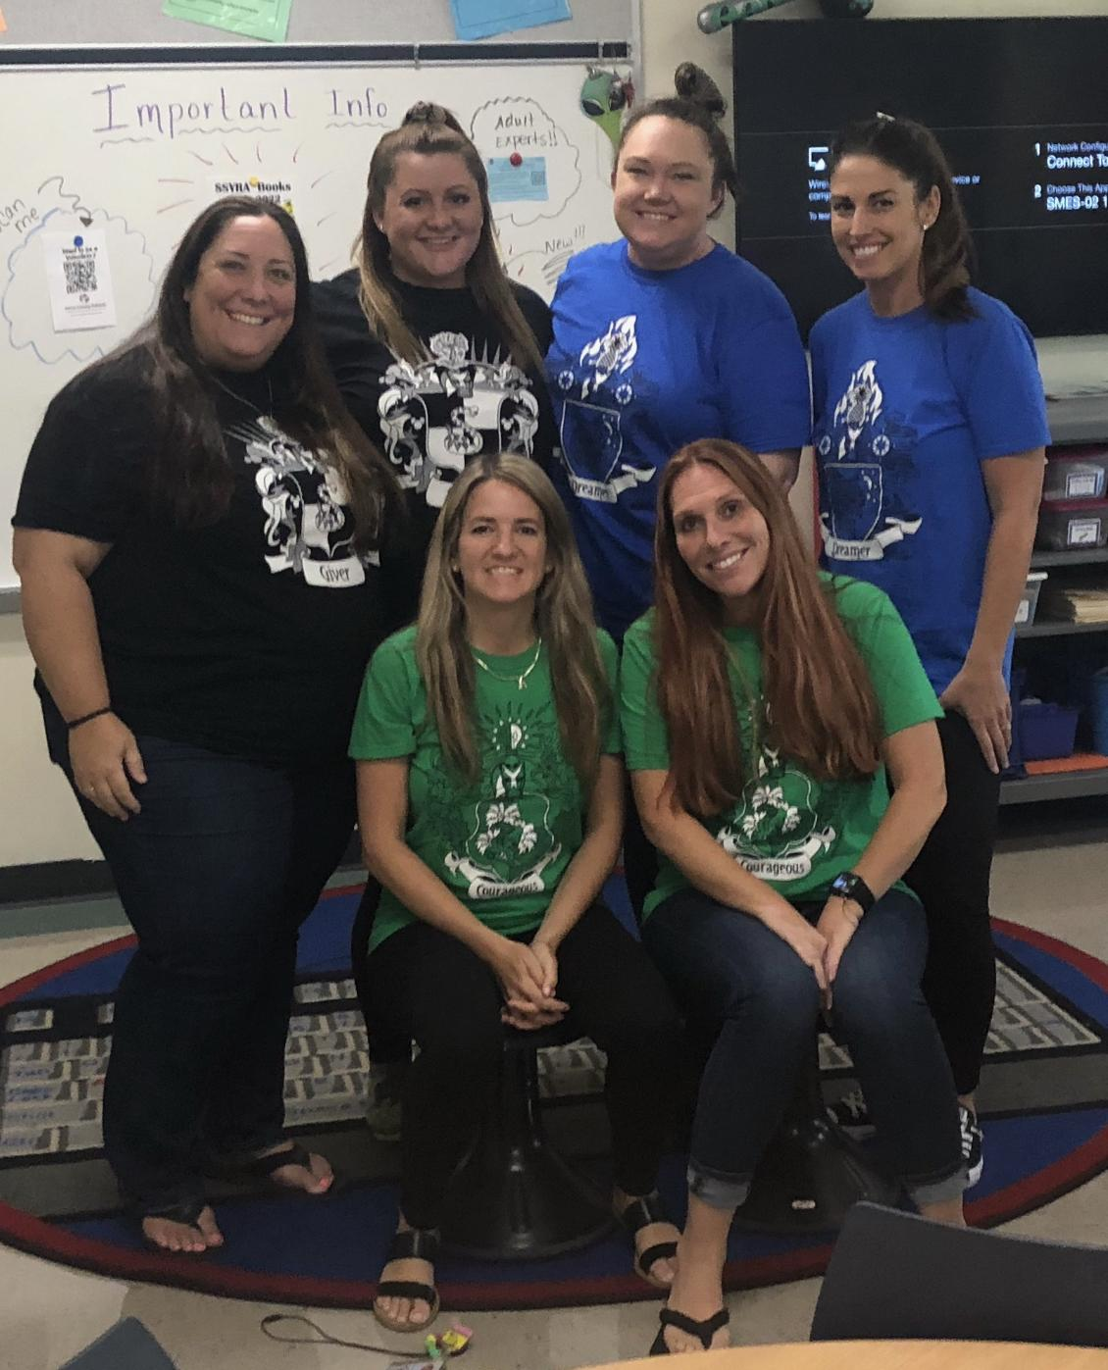
Meet the 4th Grade Teachers!

Slide 4
The 4th Grade Teachers!
Ms. Erb Born in Tampa Has a son and a daughter Enjoys being outside jerb@pasco.k12.fl.us | Mrs. Glass Born in New York Married with 2 sons Loves being a baseball mom maglass@pasco.k12.fl.us |  | Mrs. Pritchard Born in Dade City, Florida Pregnant with her first son Enjoys traveling jbodi@pasco.k12.fl.us
Mrs. Rogers Born in Ohio, raised in Land O Lakes Married with 1 son Loves reading dilworthl@pasco.k12.fl.us | Mrs. Stapf Born in Tampa Married with a daughter and son. Loves to cook and ride her bike. kbest@pasco.k12.fl.us |  | Ms. Yaw Born in Indiana Loves traveling Enjoys reading and cooking ayaw@pasco.k12.fl.us

Slide 5
School Times
8:20am- Breakfast begins to be served.
8:30am- Doors Open for students to enter the classroom. Staff members are positioned around the campus to ensure students are safe before entering their classroom.
8:40am- Instruction Begins: Students should be in classroom before 8:40 am.
2:45pm- School Ends Dismissal begins for car riders, parkers, and bus riders.
Any student arriving after the 8:40 bell, will need to be escorted by their parent to the front office for their tardy pass.

Slide 6
Early Release Days
Early Release Days Release time 12:50 pm
September 8th, 2021
October 6th, 2021
November 10th, 2021
December 8th, 2021
January 12th, 2021
February 2nd, 2021
March 9th, 2021
April 13th, 2021

Slide 7
Lunch & Specials
As of now, there will be no visitors for lunch. We will keep you posted on when you can sign up for a lunch reservation :)
4th Grade Lunch Times: 12:20-12:50 or 12:30-1:00 Daily
Specials: 10:20-11:00, except every other Wednesday 8:50-9:35
**Please see sheet sent home with class specific schedule.

Slide 8
Communication
Sanders Website- The foundation for all communication at SMES. This will allow you to see upcoming events, special flyers, school policies, grade level specific information, Twitter and Facebook feed, etc. One stop shop!
4th Grade will do ALL communication through ClassDojo.
A monthly letter will be sent home (via Dojo) about our task, standards, and happenings in the pod.
The Ron Clark Academy app is a new app we will be using at SMES. This is where your child will earn points for a job well done! All points will contribute to overall house points!
Please also refer to the sheet sent home at meet the teacher or on the first day.

Slide 10
5 Things SMES Asks of Our Parents
If you feel that there is a problem with the teacher or the style of teaching, do not call The Administration. Call the teacher first and give her a chance to discuss the concerns with you.
If you need to talk to your teacher, send a note/email/Class Dojo message. The teacher will write you back to discuss or answer any question you may have within 24 hours. Do not show up at the classroom door unannounced for a conference.

Slide 11
5 Things SMES Ask of Our Parents
Do not allow your child to be late or miss school for anything other than sickness or a death in the family. Allowing your child to miss school because he/she needs a haircut or go clothes shopping with you is sending the wrong message to children.

Slide 12
5 Things SMES Asks of Our Parents
Please realize that your child is one of many that our teachers teach in a day, and that it is not always possible to address each and every need he or she may have. The sole responsibility of educating children is not the Teacher’s alone; it is the parents/caregivers as well.
Trust our staff and teachers as they know what they are doing.

Slide 13
Quarantine Procedures
Please visit https://www.pasco.k12.fl.us/coronavirus/protocols to keep up to date with protocols and screenings.

Slide 14
Quarantine Procedures
When a student receives a quarantine order from the Department of Health, students will be able to access learning materials connected to current lessons while at home via myPascoConnect and myLearning. 4th grade teachers will send a general schedule that you may follow at home. At this time, we will not be doing a hybrid learning model.

Slide 15
Personal Devices
Our students will be using their MacBook Pros on a daily basis at school. However, there may be times where they can bring an additional device from home that can offer something different than the computers (i.e. apps, easier way to take pictures, etc). In these cases, students will be allowed to bring and use their devices ONLY if we receive the signed “BYOD” (Bring Your Own Device) form (found at http://smes.pasco.k12.fl.us/parents-2/)
Please note students WILL NOT be allowed to use cell phones or watch phones during the day. If you need to reach your child, please do so by calling the office (813-794-1500). Likewise, if a student needs to reach you, for illness, we will send them to the office. If a cell phone needs to be at school because the student needs it for after school, the phone MUST be OFF while in class.

Slide 16
Transportation Changes
Please be sure that if you have transportation changes that they are made before 2:15pm, and please send them to the front office by e-mailing.
acain@pasco.k12.fl.us

Slide 17
Security
ALL PARENTS must check in at the front office, with their driver’s license, in order to receive a visitor's badge that must be worn at all times while on campus. All parents must be placed through the Raptor System before they can attend any special events at school or come on campus for any reason. You can avoid the lines on the day of the event by having your license scanned in the Raptor System well before the event takes place and RSVP that you will be attending the event.
We will also have our School Security Guard, Mr. Steven LaVare here will us daily. All SSG’s in the district will be ARMED while on campus.
If there is a custody issue, please bring the original paperwork and we would be happy to make a copy for your child’s record.

Slide 18
PTA & Volunteering
SMES has an active PTA and SAC
PTA is available for sign up
Volunteer Coordinator: School Secretary
Please apply today if you have not already, you must register every year. (www.pasco.k12.fl.us)
Volunteers cannot go into the classroom or on field trips without being an approved volunteer through district.
As of now, volunteers are on a limited basis and will not be able to work with students.

Slide 19
Birthdays
Birthdays are special days for all students. All birthdays will be recognized by:
a crown
a coupon for a treat in the cafeteria
a song in the class
Summer birthdays are included in celebrating!
Parents may not send a treat, cupcakes, balloons, or party favors as this impedes on instructional time for all students.
If you intend to pass out birthday invitations at school, you must include the entire class. If you don’t want to invite the whole class, you must pass out invitations on your own, outside of school.

Slide 20
Homework
When teachers find it necessary, homework will begin coming home. Students will receive weekly homework. Homework will be assigned on Friday and due the following Friday. All 4th grade students will have the following homework (not necessarily each week):
Reading-Students will be assigned one passage on readworks.org weekly. All students will need to log in at home and complete and submit the assignment. They will be given their log-in during class.
Math-Math homework will be assigned on a nightly basis. Your child will be keeping their Math HW book in their book bags or at home. Please allow your child to complete his/her homework independently. We do not have any extra math books; therefore, it is imperative that your child does not lose or damage their book. If they are struggling, make a note and send it back to school THE NEXT DAY.
Writing-Writing homework will be assigned as a packet and given to students every Friday.
All students have access to all academic links through MyPascoConnect. Students will need to know their login information and password. We will be adding buttons/active links as we see the need. This means that from any computer they can access their accounts for Zearn, Florida Studies Weekly, Prodigy, etc.
**Please let us know if your child is struggling on something.

Slide 21
WIN
The fourth-grade team uses a variety of models to enrich and support students to meet their needs and identified services.
Students will receive support through: team-teaching (movement throughout the pod, when cleared to do this), small groups, and push-in.
Different models will be provided throughout the day and given based on the needs of the students in each subject area and topic.

Slide 22
Field Trips
As of now, we are not allowed to go out of county for field trips. So in house field trips we hope to be able to do are:
Gem Mining
Various speakers
When/If out of county field trips are approved, we hope to go to:
Tampa History Museum
St. Augustine 3/24/2022 at of cost of about $80 for students and about $40 for chaperones.

Slide 23
Field Trips
As of now, we have one in county field trip that is available through the district. We will be going to the Energy Marine Center (EMC) in Port Richey. This field trip is only offered to 4th grade students in the county. It is a favorite for sure!!!
The dates will be: OCT. 13 - Yaw and Stapf
OCT. 14- Rogers and Erb
OCT. 15- Glass and Pritchard
More information will be sent closer to the date. This is a FREE field trip!

Slide 25
FSA
This year your child will take 3 state assessments.
Writing
Reading
Math
The Writing Assessment will be given in April. The Reading and Math will be given in May.
(The writing score will be added to the reading score to give an overall ELA score)
Scores will most likely be sent home around the same time as this past year.
(Late June)

Slide 26
Any questions?

